Slide 1

Context Free Grammars
CSCI 265 Lecture 5
By Ariel Avshalumov

Slide 2
What we learned in chapter 1
Two distinct but equivalent methods to describe regular languages
We saw that there are cases when it’s easier to use a DFA or an NFA or even a REGEX expression

Slide 3

Context-free grammars (CFGs)
These are more powerful than finite automata
The reason for this is that they have more memory
We’ll see what that means soon

Slide 4

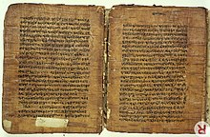
Origins of context-free grammars
Where did these come from?
This idea has been around for millennia
Specifically they’ve been used by linguists to describe language
The earliest known use of them has been by Pāṇini who was an ancient Sanskrit scholar from the Indian subcontinent
He is dated as being from between the 6th – 5th century bc

Slide 5
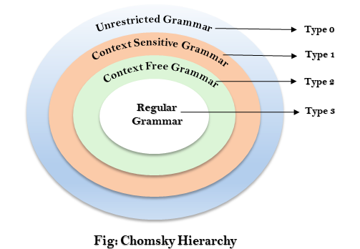
The big picture
The collection of languages associated with CFGs are called the context-free languages
Inside of this collection you can find all of our regular languages as well as other ones because.
Anything a finite automata can do, a CFG can do just as well (if not better)!

Slide 6
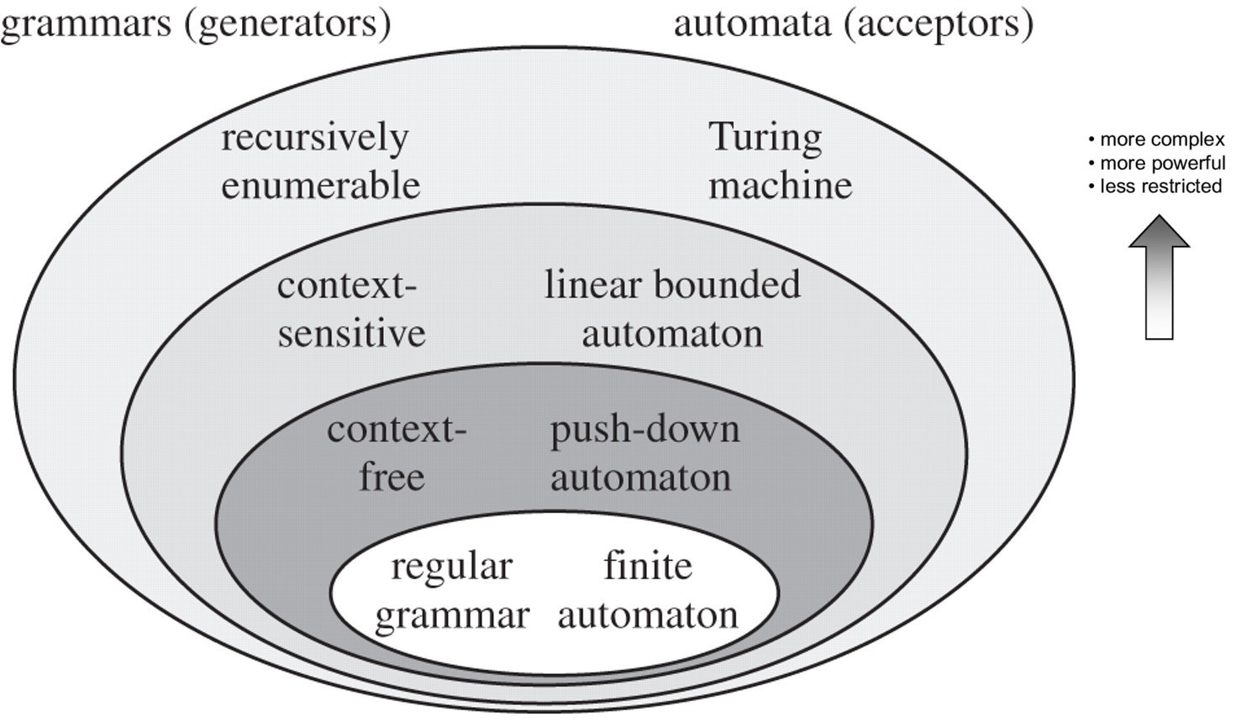

Slide 7
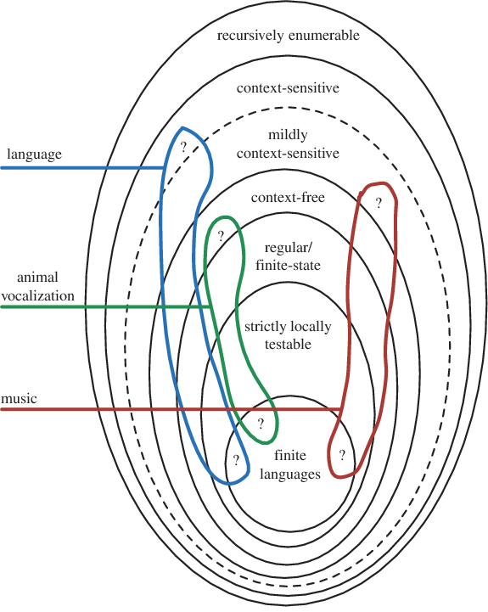

Slide 8
Example CFG
John, whose blue car was in the garage, walked to the grocery store.
Might be translated to a CFG like so:
[John[, [whose [blue car]] [was [in [the garage]]],]] [walked [to [the [grocery store]]]].
You see those parentheses?
They allow us to break up a sentence into a set of words

Slide 9

How we write CFGs
Let’s look at an example from the book which is called G1
$$A →0A1$$
$$A →B$$
$$B →\#$$
What does this grammar describe?

